Slide 1
Transforming Rare Disease Journeys Friends & Family Funding Presentation

Slide 2
AGENDA
Our Story
The Market
Radiant Compass
Our Plan
Our Ask

Slide 3

The team
Andrew Fegley
Rob Koch
Jonathan Lupo
Connor Fegley
Patient Co-Founder & CEO
Co-Founder (NXT Humans)
Co-Founder (NXT Humans)
Co-Founder
25+ years technology product management experience
Currently navigating epithelioid mesothelioma journey
Authentic patient voice with deep understanding of care gaps
Proven ability to translate complex medical information using AI
Serial digital entrepreneurs with proven track record
Deep expertise in AI/ML platform development
$500M+ in cumulative project delivery
Network of healthcare and technology advisors
Serial digital entrepreneurs with proven track record
Deep expertise in AI/ML platform development
$500M+ in cumulative project delivery
Network of healthcare and technology advisors
Digital transformation and AI consultant
Next-generation perspective on healthcare technology
Family commitment to mission and patient advocacy

Slide 4
Our Story

Slide 5
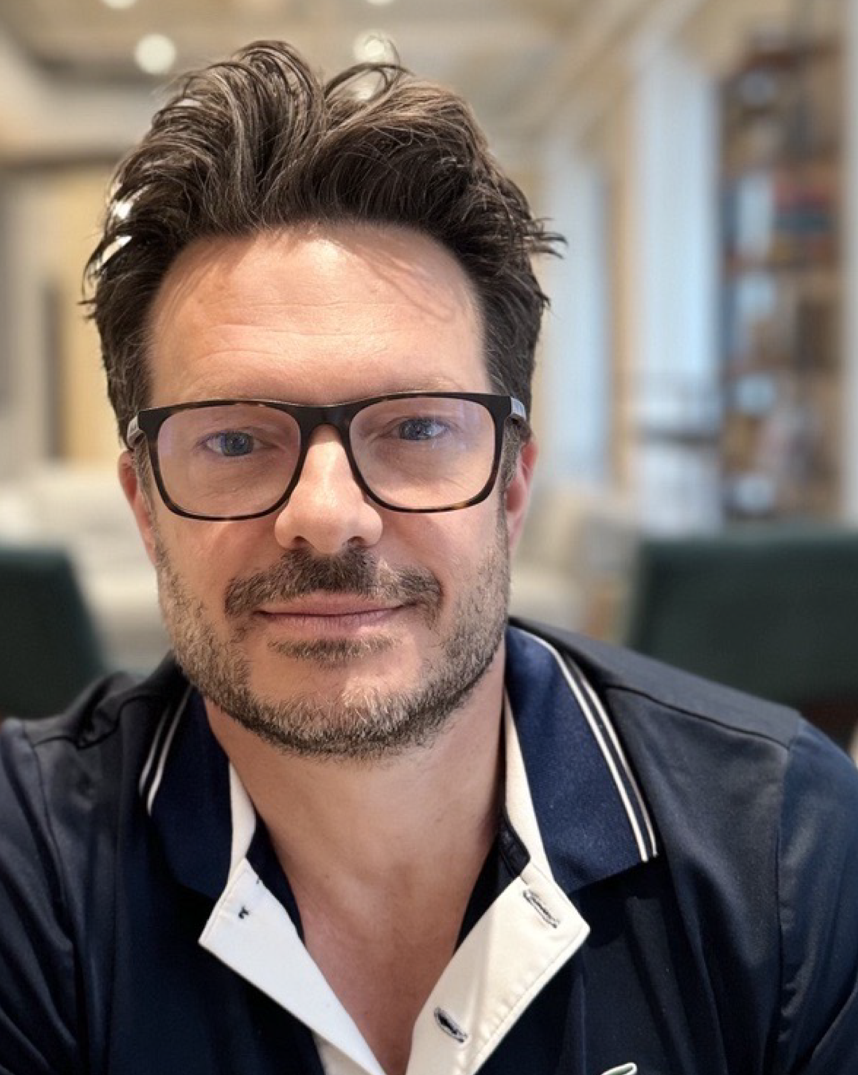
Andrew’s journey
When Radiant Compass transforms the care journey for patients and families — when it brings clarity to the confused, hope to the afraid, and light to those lost in the shadows of rare disease — remember where it came from. Remember this story.
When my dad was diagnosed with a rare abdominal cancer, he did what so many patients are forced to do: he grieved… then he got to work. With quiet strength and fierce resolve, he dove headfirst into research, treatments, second opinions, diet, movement, sleep — anything to give himself the best shot. And he will win.
Our family rallied behind him. We built spreadsheets and folders, tracked notes and test results, pieced together a care plan from a thousand fragments. But something was missing — not in our love, but in the system meant to support us.
Not even two weeks after his diagnosis, my dad saw what countless others face: a lack of guidance, of structure, of emotional and logistical support for people navigating rare and overwhelming illnesses. And so, even while fighting for his own life, he did what visionaries do.
Radiant Compass was born.
Radiant Compass isn’t just an app. It isn’t just a platform. It’s a lifeline. A hand to hold when the ground disappears beneath you. A guide when the path is dark and uncertain. It’s the belief that no one should walk through this alone.
It’s a promise — to patients, to caregivers, to families — that someone sees you, hears you, and stands with you.
Radiant Compass is love made actionable. It is a system built from personal pain, transformed into collective strength. It’s not just here to help people survive rare disease. It’s here to help them live through it — with dignity, direction, and hope.
My dad’s journey will be hard, but he will not walk it alone. And now, no one else has to either.

Slide 6
From Personal Crisis to Global Solution
The Problem That Changed Everything
400,000 U.S. patients receive a rare cancer diagnosis each year. Each one faces the same devastating reality Andrew Fegley encountered when diagnosed with epithelioid mesothelioma:
"From the first time a patient has an inclination there is 'something wrong,' they are forced into an information deficit loop. Without GPT, I'd be lost; without RadiantCompass, millions still will be."
— Andrew Fegley, Patient Co-Founder

Slide 7
Five Critical Gaps Every Rare Disease Patient Faces
1. "Where do I even go?"
Patients cold-call multiple "centers of excellence," juggling separate portals at Penn, MSK, MD Anderson, and more
2. Insurance roadblocks
70% of rare disease families report financial toxicity within 12 months
3. Medical jargon chaos
Pathology reports arrive in "12th-grade medicalese" that 9 out of 10 patients can't understand
4. Lost data, lost hope
Valuable patient experiences sit in siloed portals, unable to help accelerate cures for others
5. Fragmented emotional support
Prayer, meditation, and mental health exist in separate apps, disconnected from medical care

Slide 8
Our Vision
Transform every rare disease diagnosis—from the first incomprehensible lab result to lasting remission—into a guided path of clarity, compassion, and choice.

Slide 9
THE MARKET

Slide 10
A $12B Market Crying for Innovation
Market Opportunity
Global Rare Disease Population | 400M + people worldwide
U.S. Rare Cancer Patients | 400K new diagnoses annually; 10M+ globally
Market Size | $12B global rare disease real-world evidence market
Growth Rate | 18$ CAGR (IQVIA, 2025)
Why Now?
AI Translation Breakthrough: We've proven AI can convert complex pathology reports into 6th-grade prose in 27 seconds
Regulatory Support: FDA increasingly values real-world evidence for rare disease drug approvals
Patient Empowerment: Patients demand ownership of their health data and meaningful participation in research
Fragmented Competition: No single platform offers comprehensive rare disease navigation—massive whitespace opportunity

Slide 11
Competitive Landscape gap
RadiantCompass fills the whitespace with end-to-end rare disease journey orchestration.
Why Now?
Current solutions focus on narrow problems:
Outcomes4Me → Common cancer guidelines only
Belong.Life → Peer forums without decision tools
AllStripes/Ciitizen → Data aggregation without navigation

Slide 12
A NEED EXISTS
METRIC | MEASUREMENT | TARGET | ACTUAL
Audience attendance | # of attendees | 150 | 120
Engagement duration | Minutes | 60 | 75
Q&A interaction | # of questions | 10 | 15
Positive feedback | Percentage (%) | 90 | 95
Rate of information retention | Percentage (%) | 80 | 85
Learn to infuse energy into your delivery to leave a lasting impression
One of the goals of effective communication is to motivate your audience

Slide 13
Radiant Compass
The World's First Whole-Person Rare Disease Navigator

Slide 14
THE SOLUTION: RADIANT COMPASS
Personalized Care Journey Navigator An adaptive, stage-based roadmap that guides patients and caregivers through diagnosis, treatment, and long-term living with clarity and compassion.
Collaborative Care Planning & Logistics Hub A centralized tool for managing appointments, records, communication, and responsibilities across care teams, families, and support networks.
Emotional & Mental Health Companion Integrated journaling, check-ins, peer stories, and therapeutic prompts to help users process emotions, reflect, and build resilience over time.
Empowered Decision Support & Advocacy Tools Evidence-based resources for comparing treatment options, understanding second opinions, estimating costs, and finding purpose through mentorship, research, and storytelling.

Slide 15
THE SOLUTION: RADIANT COMPASS
An AI-powered platform that transforms the rare disease experience through three breakthrough capabilities:
Insert Image
Clarity Engine - Medical Translation AI
Converts complex pathology, genomics, and treatment plans into plain language
Generates personalized "ask-your-doctor" checklists
Provides real-time explanations of medical terminology and next steps

Slide 16
THE SOLUTION: RADIANT COMPASS
An AI-powered platform that transforms the rare disease experience through three breakthrough capabilities:
Insert Image
Compare-My-Care™ - Treatment Center Intelligence
Ranks hospitals by procedure volume, outcomes, insurance coverage, travel burden, and culture
Eliminates the "cold-calling centers of excellence" nightmare
Provides objective data to guide life-changing treatment decisions

Slide 17
THE SOLUTION: RADIANT COMPASS
An AI-powered platform that transforms the rare disease experience through three breakthrough capabilities:
Insert Image
Care-Circle Workspace - Journey Orchestration
Role-based dashboards for patients, caregivers, and support circles
Automated appointment coordination, symptom tracking, and insurance navigation
Integrated Faith & Mind Studio for spiritual and emotional support

Slide 18
Core Value Propositions
For Launch – Primary focus on patients, their families and Caregiver Networks
Navigate complex healthcare decisions with confidence
Access plain-language medical insights instantly
Connect with best-fit treatment centers and specialists
Coordinate care logistics seamlessly with family support
Secondary and Tertiary beneficiaries of the platform:
Healthcare Systems that can benefit from:
Reduction in administrative burden through automated coordination
Improvement in patient engagement, satisfaction and outcomes
Access to structured real-world evidence for quality improvement within their firms
Big Pharma, Biotech and other Research Institutions that can benefit from Radiant’s Data by:
Helping to accelerate drug development with regulatory-grade real-world data
Create better connections with engaged patient populations for clinical trials
Generate evidence that helps support rare disease treatment optimization

Slide 19
Core Value Propositions
Technology Differentiators
Proprietary Rare Disease Knowledge Graph – we anticipate creating and connecting 7,000+ conditions through our proprietary Radiant Compass database
Regulatory-Grade FHIR Pipeline ensuring research-quality data
Patient-Consented Real World Evidence (RWE) Data Marketplace with revenue sharing opportunities for data contributors (future phase post-launch)

Slide 20
Go-to-market strategy
Phase 1: Rare Cancer Beachhead
(Months 1-18)
Target:
Mesothelioma, sarcoma, and rare GI cancers and/or explore other cancer focus areas
Partner with 3-5 rare cancer patient foundations for trust and distribution
Launch Compare-My-Care™ as a pilot and/or freemium entry point
Build initial user base of 1,000 patients / care givers (TBD on if there is a fee and/or distributed through partnering Health networks (such as University of Penn, MSK, etc.)
Phase 2: Healthcare System Integration (Months 12-24)
Target:
Cancer centers and specialty oncology practices
White-label Clarity Engine for patient portals
Care coordination platform for multidisciplinary teams
Consider enabling - $2-6 Per Member / Per Month (PMPM) licensing model for health systems
Phase 3: Payer & Employer Expansion
(Months 18-36)
Target:
Health plans and employer benefits
Decision support APIs for member portals
Cost containment through optimized care pathways
$1 PMPM API access model
Phase 4: Research Marketplace
(Months 24-48)
Target:
Pharmaceutical, Biotech companies and research institutions
De-identified longitudinal data for drug development
Patient recruitment for clinical trials
Tiered dataset pricing with 10% patient revenue share (percentages need to be validated and market tested)

Slide 21


Slide 22
OUR PLAN

Slide 23
Roadmap to Success
build prototype
build team
series A
scale/protect/etc
Immediate Priorities (Months 1-9)
Build the MVP
Develop the branding, design and development of the following feature sets and benchmarks:
Establish and Finalize Branding (e.g., visual look and feel and all application aesthetics)
Compare-My-Care™ development with hospital ranking algorithm
Launch Clarity Engine with medical translation AI
Establish patient foundation partnerships or other partnerships that will help us to recruit and onboard beta users
Recruit 200 beta users through patient foundation partnerships and other channels
Capital Required: ~ $750K

Slide 24
Growth Phase (Months 10-18)
build prototype
build team
series A
scale/protect/etc
Validate Business Model
Secure first hospital SaaS pilot contract
Launch payer API pilot program
Reach 1,000 paying patients (TBD on whether patient of care institution or otherwise pays)
Prepare 510(k) decision-support submission
Capital Required: $1.3M

Slide 25
Series A Preparation (Months 16-24)
build prototype
build team
series A
scale/protect/etc
Scale for Investment
Demonstrate product-market fit with enterprise contracts
Expand to 3 additional rare cancer types
Build regulatory moat with FDA clearance
Series A Target: $8-12M at $40-60M valuation

Slide 26
Long-term Vision (Years 2-5)
build prototype
build team
series A
scale/protect/etc
Market Leadership
Expand to all 7,000+ rare diseases
International market entry
Strategic partnerships with major health systems
IPO readiness with dominant market position and/or significant acquisition by Tier 1 strategic buyer (e.g., Pharma, Health Insurer, Hospital System or otherwise)

Slide 27
THE ASK

Slide 28
Our Ask: $2M Friends & Family Round
raise amount
usage of funds (team, business case, etc)
valuation (SAFE?)
Funding Structure
Investment Vehicle: SAFE (Simple Agreement for Future Equity)
Valuation Cap: $15M
Discount: 20% for early investors
Conversion: Automatically converts to equity in Series A
Use of Funds
Team Building (40% - $800K)
CTO and lead AI engineer
Clinical advisory board
Patient experience designer
Regulatory affairs consultant
Product and Data Development (35% - $700K)
MVP completion and testing
FHIR pipeline development
Mobile app development
Security and compliance infrastructure
Market Validation (15% - $300K)
Beta user acquisition
Partnership development
Pilot program execution
Regulatory submission preparation
Operations & Legal (10% - $200K)
Legal and regulatory compliance
Office setup and equipment
Insurance and business development
Accounting and administrative systems

Slide 29
Why Invest Now?
raise amount
usage of funds (team, business case, etc)
valuation (SAFE?)
Compelling Opportunity:
Massive underserved market with proven pain points
Experienced founding team with lived patient experience
Breakthrough AI technology already validated
Clear path to Series A with enterprise traction
Investment Upside:
Ground-floor entry at attractive valuation
High-growth market with defensible moats
Mission-driven business with social impact
Strong potential for strategic acquisition or IPO
Risk Mitigation:
Proven founder-market fit with Andrew's patient journey
LOIs already secured with Penn Integrative Oncology and payer innovation lab
Regulatory pathway established with IRB draft approval
Experienced team with $1B+ in prior project delivery

Slide 30
The Right People for This Mission
raise amount
usage of funds (team, business case, etc)
valuation (SAFE?)
Andrew Fegley - Patient Co-Founder & CEO
25+ years digital digital technology consulting and management experience
Currently navigating epithelioid mesothelioma journey
Authentic patient voice with deep understanding of care gaps
Proven ability to translate complex medical information using AI
Rob Koch & Jonathan Lupo - Co-Founders (NXT Humans)
Serial digital entrepreneurs with proven track record
Deep expertise in AI/ML platform development
$500M+ in cumulative project delivery
Network of healthcare and technology advisors
Connor Fegley - Co-Founder & Nepo-Baby
Digital transformation and AI consultant
Next-generation perspective on healthcare technology
Family commitment to mission and patient advocacy
Advisory Network (In Development)
Medical oncology expertise from leading cancer centers
Regulatory affairs specialists with FDA experience
Patient advocacy leaders from rare disease community
Healthcare technology investors and operators

Slide 31
THANK YOU
------------
------@---------.com
215--------

Slide 32

Overcoming nervousness

Slide 33
Engaging the audience
Techniques for connecting
Make eye contact with your audience to create a sense of intimacy and involvement
Weave relatable stories into your presentation using narratives that make your message memorable and impactful
Encourage questions and provide thoughtful responses to enhance audience participation
Use live polls or surveys to gather audience opinions, promoting engagement and making sure the audience feel involved

Slide 34
Selecting Visual Aids

Slide 35
Effective delivery techniques
Voice modulation
Body language
This is a powerful tool in public speaking. It involves varying pitch, tone, and volume to convey emotion, emphasize points, and maintain interest:
Pitch variation
Tone inflection
Volume control
Effective body language enhances your message, making it more impactful and memorable:
Meaningful eye contact
Purposeful gestures
Maintain good posture
Control your expressions

Slide 36
Navigating Q&A Sessions
Preparing for questions
Maintaining composure
Know your material in advance
Anticipate common questions
Rehearse your responses
Maintaining composure during the Q&A session is essential for projecting confidence and authority. Consider the following tips for staying composed:
Stay calm
Actively listen
Pause and reflect
Maintain eye contact

Slide 37
Dynamic delivery
METRIC | MEASUREMENT | TARGET | ACTUAL
Audience attendance | # of attendees | 150 | 120
Engagement duration | Minutes | 60 | 75
Q&A interaction | # of questions | 10 | 15
Positive feedback | Percentage (%) | 90 | 95
Rate of information retention | Percentage (%) | 80 | 85
Learn to infuse energy into your delivery to leave a lasting impression
One of the goals of effective communication is to motivate your audience

Slide 38
Final tips & takeaways
Practice makes perfect
Continue improving
Consistent rehearsal
Strengthen your familiarity
Refine delivery style
Pacing, tone, and emphasis
Timing and transitions
Aim for seamless, professional delivery
Practice audience
Enlist colleagues to listen & provide feedback
Seek feedback
Reflect on performance
Explore new techniques
Set personal goals
Iterate and adapt

Slide 39
Speaking engagement metrics
IMPACT FACTOR | MEASUREMENT | TARGET | ACHIEVED
Audience interaction | Percentage (%) | 85 | 88
Knowledge retention | Percentage (%) | 75 | 80
Post-presentation surveys | Average rating | 4.2 | 4.5
Referral rate | Percentage (%) | 10 | 12
Collaboration opportunities | # of opportunities | 8 | 10

